Slide 1

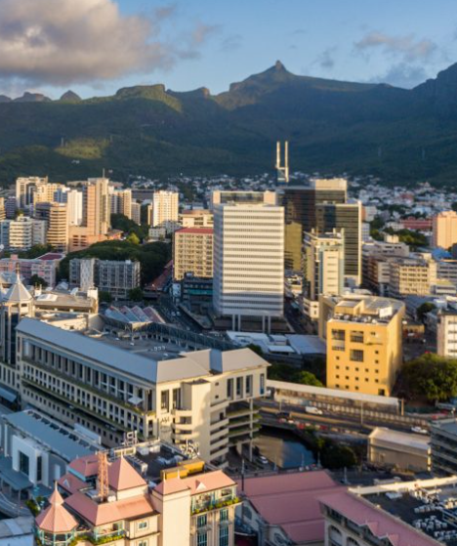



AI-DRIVEN URBAN
MOBILITY

Slide 2
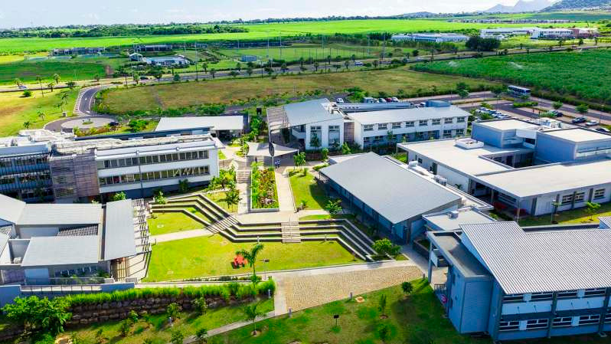


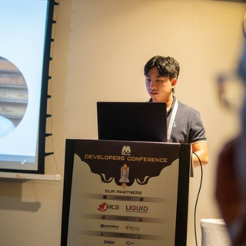
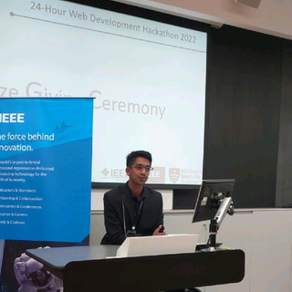


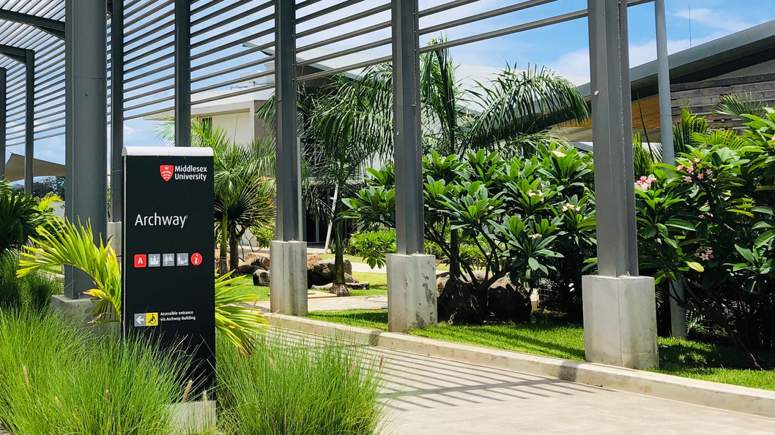
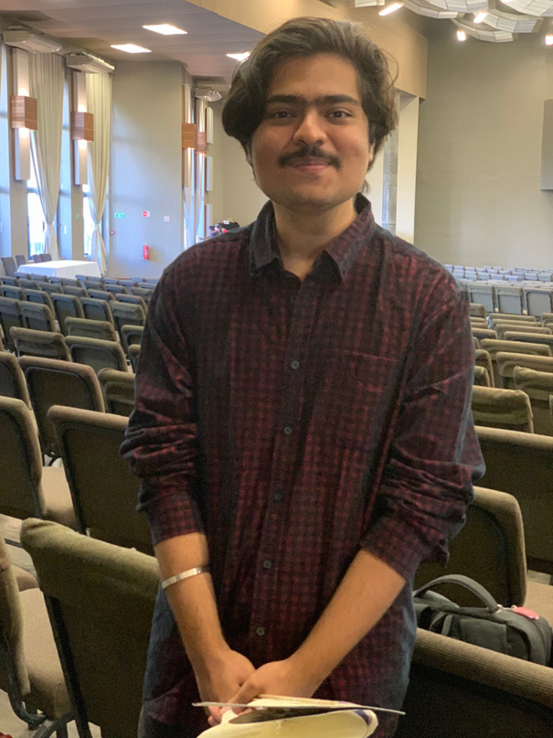
OUR TEAM
Dereck Lam Hon Wah
Noor Joomun
Software Engineer | BSc Computer Science (System Engineering) May 2024 | Chairperson of IEEE Middlesex University Mauritius Student Branch
Webmaster at IEEE Middlesex University Student Branch | Final Year Computer Science (System Engineering) Student
Lakshit Sharma
Annu Radha
Final Year Computer Science (System Engineering) Student
Vice-Chairperson at IET MDX | BSC Computer Science (System Engineering) Student at Middlesex University Mauritius
Haardik Gautam
Assistant Webmaster at IEEE Middlesex University Student Branch | 2nd Year BSc .Cyber Security and Digital Forensics Student

Slide 3
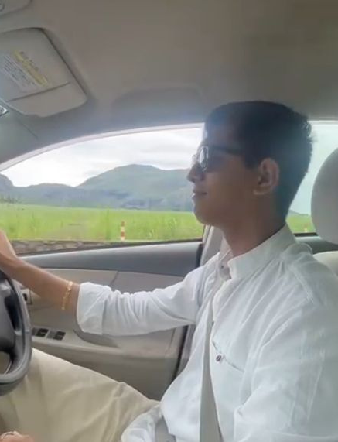
MEET SHARMA
17,038 road accident during the first semester of 2023
INCREASE in road accident by 0.5% during the first semester of 2023
End of December 2022, 648,176 vehicles were registered at the National Land Transport Authority (NTA)
Sharma,a 21 year-old student faces challenges to meet his girlfriend Annu due to Traffic Congestions and feel unsafe on the road
Increase of 25,188 or +4.0% compared at the end of December 2021

Slide 4
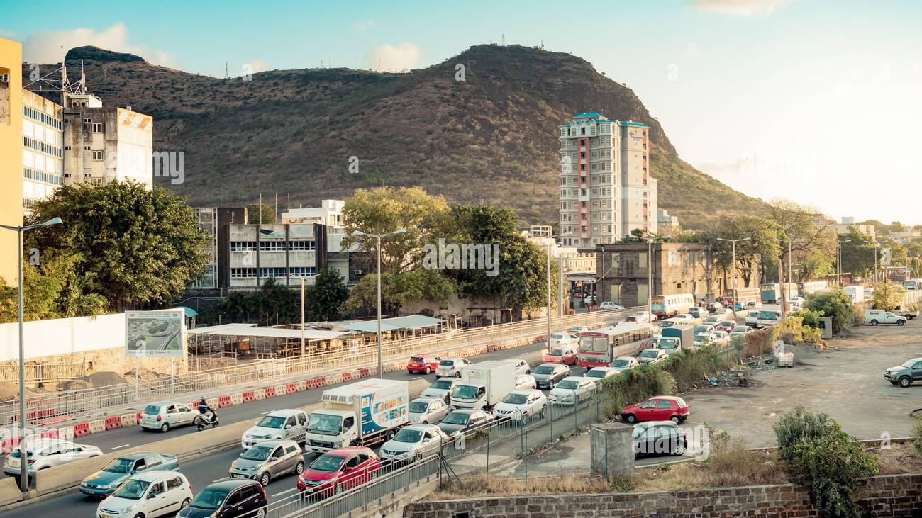
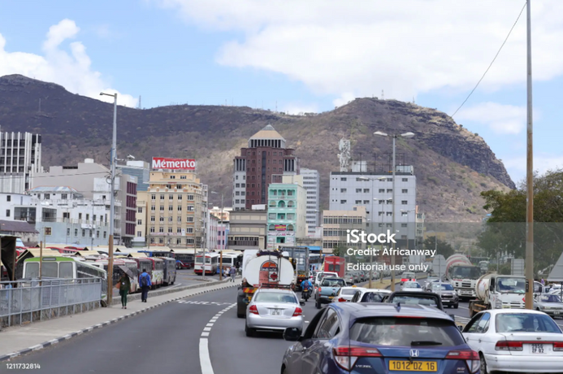
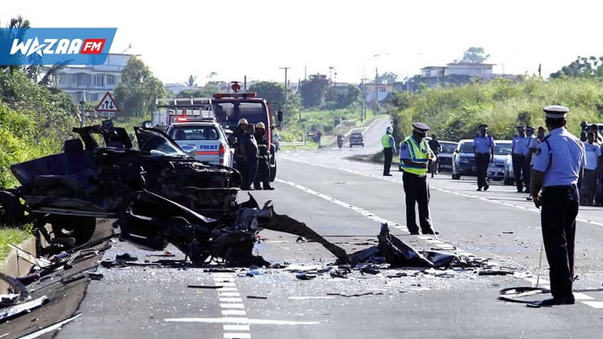
PROBLEM ANALYSIS
01
Traffic Congestion
02
Inefficient Traffic and Public Transport Route Management Systems
03
Lack of Driver's Safety Features in Current Mobile Apps
04
Road Safety Concerns
05
Low Public Awareness and Adoption

Slide 5

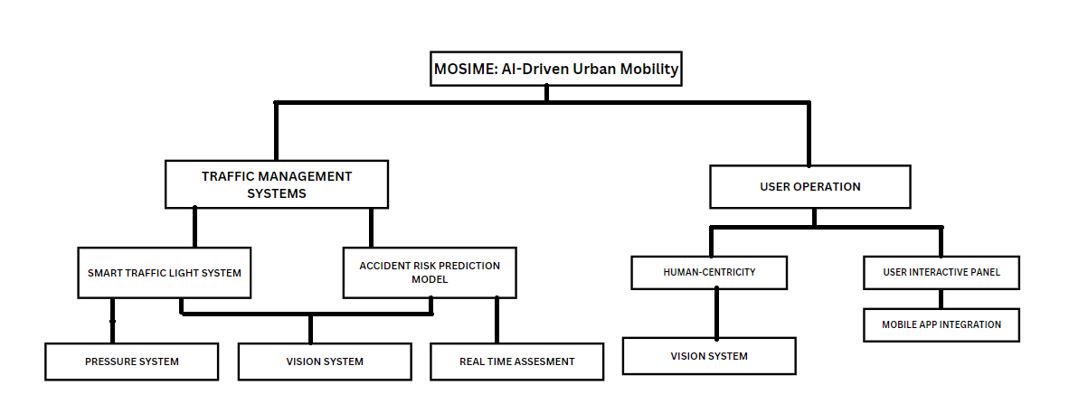
PROJECT PROPOSAL
AI-Driven Urban Mobility

Slide 6



EXISTING SOLUTIONS
PRICE
STLS
ARPM
PERSONALISATION
MOBILE APP
FEATURES
Mosime
?
NoTraffic
Google Maps
?
Aimsun

Slide 7
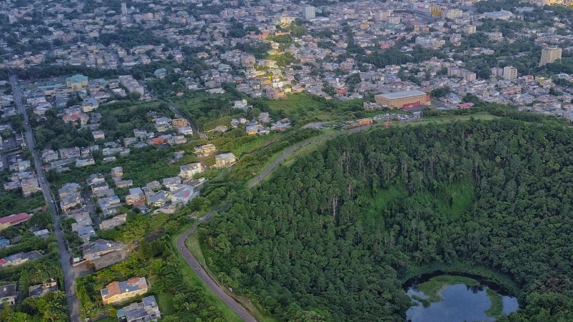



PROJECT TIMELINE
A 3 phase project approach, we encompass a wide variety of tools, applications, and methodologies to transform raw data from multiple sources into meaningful and actionable information.
PHASE 3
Mobile App Integration
Driver's Safety Features
PHASE 2
Smart Traffic Light System,
Accident Risk Prediction, Public
Transport Route Optimization
PHASE 1
Data Collection,
Analysis and Integration

Slide 8
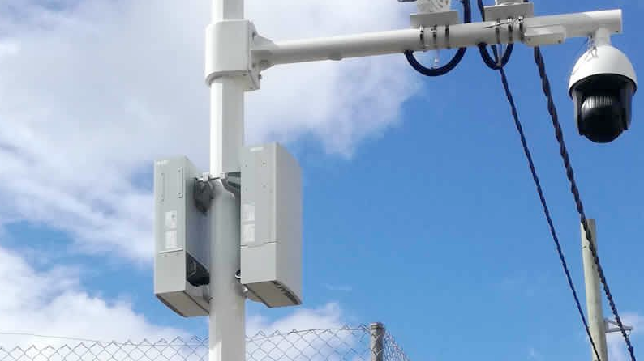





BUSINESS INTELLIGENCE IN PROJECT DESIGN
Structured
Iterative Feedback
Risk management
User Adaptation
Flexibility
Progression
Iterative Feedback
Risk Management
User Adaptation
Flexibility
To focus on specific challenges step by step, ensuring each aspect is addressed thoroughly without overwhelming the system.
After each phase completion, feedback is gathered to ensure that subsequent phases are built on validated refinement from the previous ones.
By not deploying all features at once, the project risks are managed one phase at a time without affecting the whole.
Introducing users to new features gradually reduces resistance to change and increases their comfort with the system.
If external factors occur (e.g., new technology emerges), the phased approach allows for adjustments in the subsequent phases without overhauling the entire system.

Slide 9



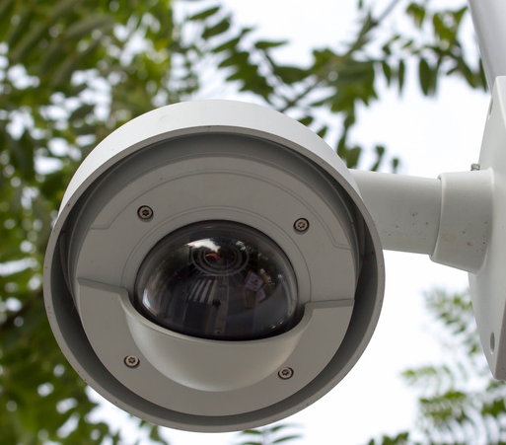
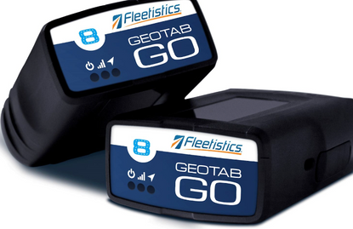
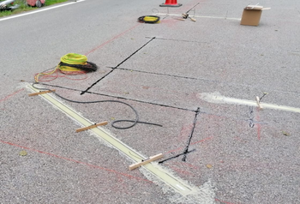
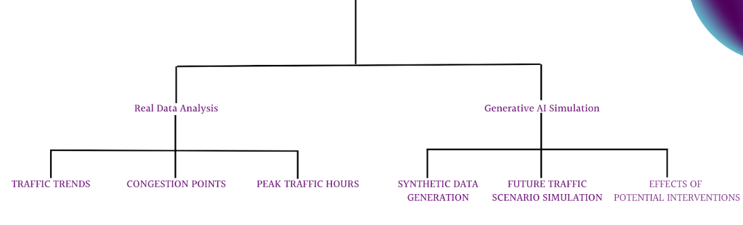
PHASE 1 DATA COLLECTION, ANALYSIS AND INTEGRATION
DATA COLLECTION
Safe City Camera
Telematic Device Car
Pressure Sensor
DATA ANALYSIS

Slide 10
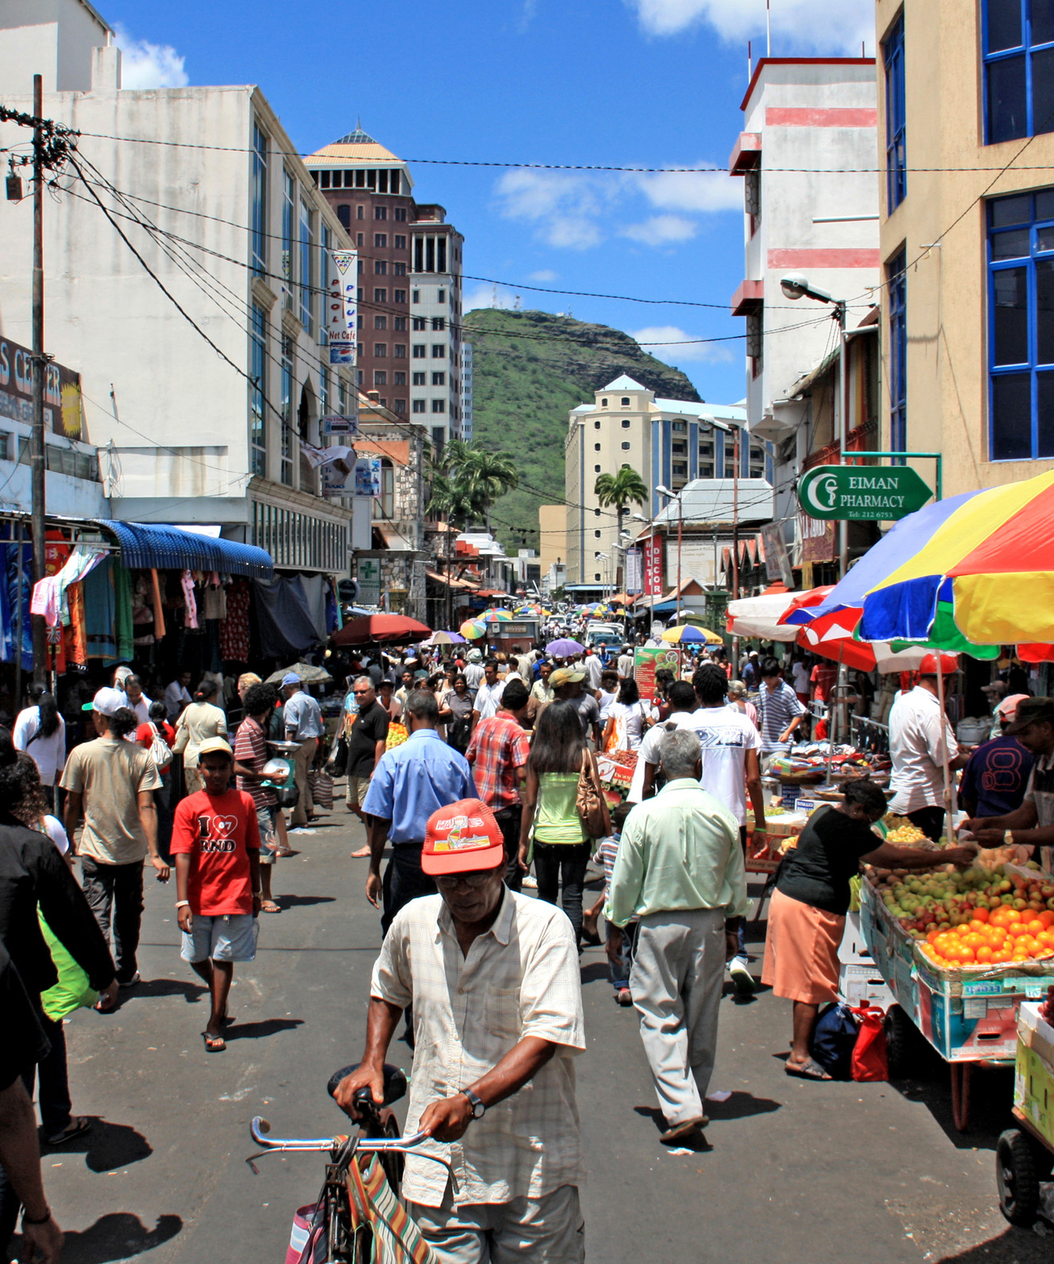



PHASE 1 DATA COLLECTION, ANALYSIS AND INTEGRATION
DATA INTEGRATION
APIs (Application Programming Interfaces) developed to fetch data from sensors and integrate it into the mobile app.
Data Fusion: Data from various sensors fused to provide a comprehensive view of traffic conditions. ow.
Real-time Updates: The mobile app receives updates from the server every few seconds, ensuring that drivers have the most recent information.
Predictive Analysis: ML algorithms analyse historical traffic data to predict future traffic conditions, allowing the app to provide recommendations

Slide 11
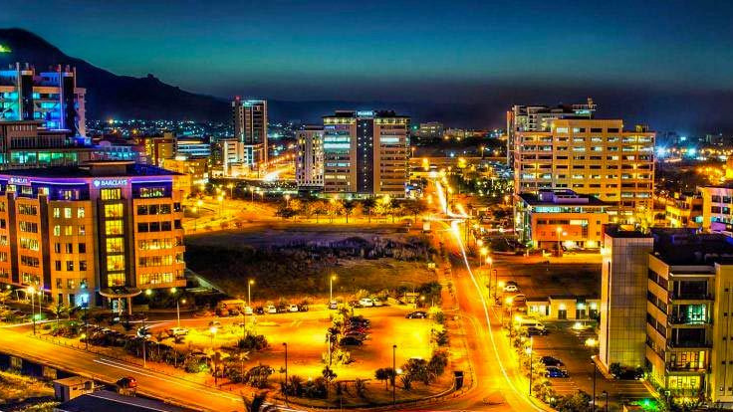
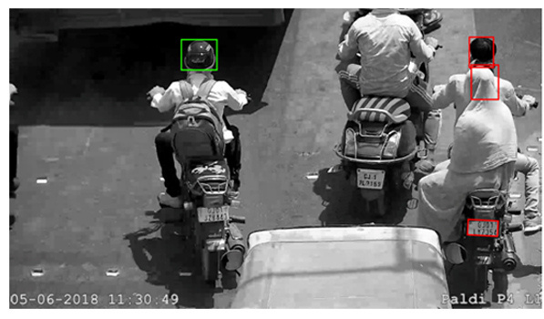
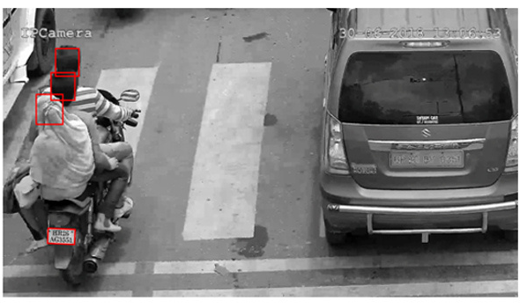
PHASE 2 STLS & ARPM
SMART TRAFFIC LIGHT SYSTEM
Real-time traffic light status and predictions for informed decisions.
Sensors for Data Accuracy:
- Inductive Loop Detectors
- Infrared, ultrasonic, and acoustic sensors.
YOLO Algorithm for Traffic Light Control:
- Detects and classifies vehicles.
- Dynamic traffic signal timing adjustment.
- Factors considered: Traffic density, vehicle counts, startup lag,
Adaptive Approach:
- Synchronize traffic signals across multiple intersections for
optimal traffic flow

Slide 12





PHASE 2 STLS & ARPM
ACCIDENT RISK PREDICTION MODEL (APRM)
01
02
Enhance Infrastructure Planning
Accident Prediction
Regular CCTV footage of roads are a valuable resource to identify areas requiring improvements, such as better signage, adding guardrails, improved lighting, road widening, or safer intersections.
To efficiently plan safety measures based on forecasts of when and where accidents may occur, MOSIME aims to detect incidents and promptly alert emergency services, potentially saving lives.
04
APRM
03
05
Share real-time road conditions
Detect road anomalies
Mileage Tracking
Continuously assessing real-time road conditions, including factors like water accumulation, and share updates with drivers.
Road anomalies like erratic driving behaviour, sudden stops, or unexpected objects, promptly alerting authorities and fellow drivers.
Provide fuel efficiency tips based on driving behaviour and historical data, promoting economical driving habits.

Slide 13
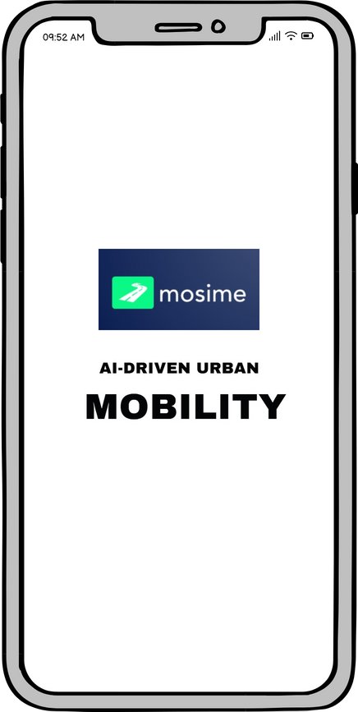
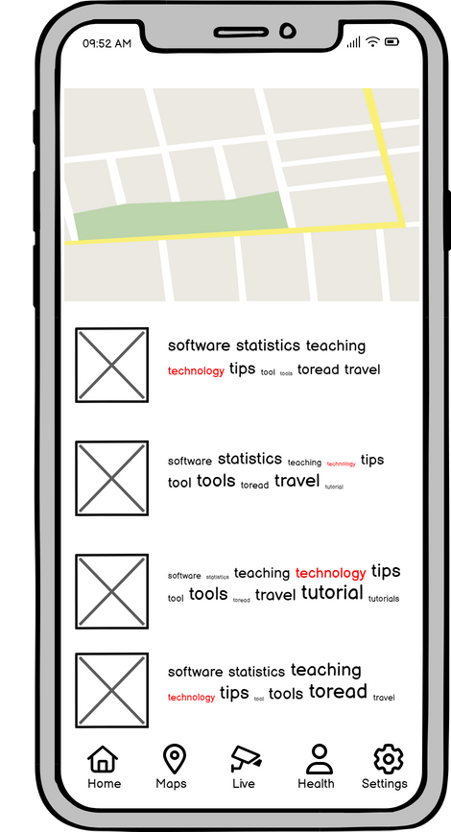
PHASE 3 MOBILE APP INTEGRATION
Sentiment Analysis Model
Helmet Detection
Speed Violation Detection
This ensures that two-wheeler drivers are adhering to safety norms by wearing and properly fastening helmets.
It uses a machine learning model to analyse driver inputs and helps in mitigating risks by suggesting breaks or in app interactions that soothes the drivers.
The GPS and local speed limit data alerts the drivers for speed limit breaches and suggests alternate routes to prevent recurring violations.
Number Plate Detection
Traffic Light Status
Real Time Alerts
The app displays the current status of traffic light (red, yellow, green) and the countdown for the next traffic light change
The drivers receive real time updates that allow them to adjust their speed accordingly. Users can provide feedback on the accuracy of predictions, helping to improve the system over time.
This capability of app is essential in reporting incidents, locating vehicles, and aiding parking management.

Slide 14



Business Sustainability
Environmental Sustainability
Economic Sustainability:
Social Consideration
Environmental Sustainability
Economic Sustainability
Social Consideration
Prioritizes energy efficiency and user safety.
Optimizes background processes, minimizing battery usage.
Promotes emission reduction via eco-friendly commuting routes.
Uses geolocation and mapping APIs for carbon emissions reduction.
Diversifies revenue through subscriptions and targeted ads.
Analyzes user behavior for personalized advertising.
Optimizes server costs and third-party integrations.
Implements dynamic server resource allocation for energy savings.
Prioritizes user data protection with AES-256 encryption.
Ensures data security through military-grade encryption.
Guarantees secure data transmission and storage.

Slide 15
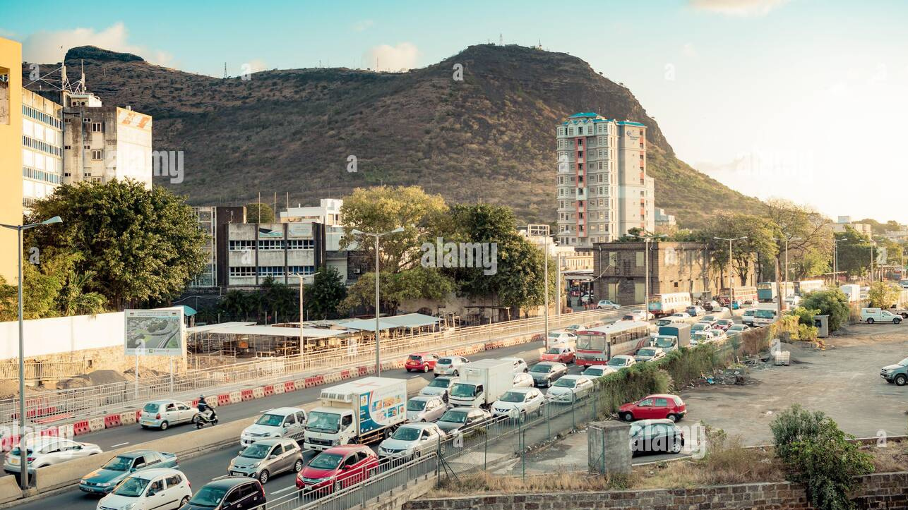

Human Centricity
Well Being
Needs
The overall quality of life and happiness of individuals, including physical, mental, and emotional health
Different individuals have different needs
Values
Humans follow certain values that should be respected and followed
Notes:
Transparency in AI is paramount. It means that AI systems should operate in a way that is understandable and explainable to humans. As it helps build trust.
Ethical considerations guide the development and deployment of AI. We must ensure that AI aligns with our values and respects human rights without any bias or discrimination.
Safety is non-negotiable. AI systems should not pose risks to human life, privacy, or security. It is also important to regularly update AI algorithms to adapt to latest threats.
Personalisation facilitates a more user friendly and tailored experience. AI can provide solutions according to needs which might be individual specific.

Slide 16
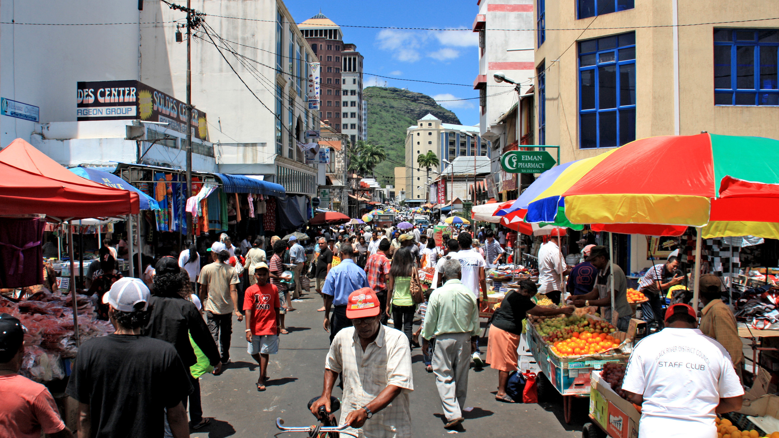




MOSIME CO-EXISTENCE
Data Collection
Trust
Preferences
Driving Habits
CO-EXISTENCE
Transparency
Personalization
Ethical
Consideration
Safety
Fairness
Privacy
Without
Distractions
Detect Danger
Notes:
Transparency in AI is paramount. It means that AI systems should operate in a way that is understandable and explainable to humans. As it helps build trust.
Ethical considerations guide the development and deployment of AI. We must ensure that AI aligns with our values and respects human rights without any bias or discrimination.
Safety is non-negotiable. AI systems should not pose risks to human life, privacy, or security. It is also important to regularly update AI algorithms to adapt to latest threats.
Personalisation facilitates a more user friendly and tailored experience. AI can provide solutions according to needs which might be individual specific.

Slide 17
ETHICS AND GOVERNANCE
The 2018/19 Budget laid the groundwork for AI in Mauritius, leading to the creation of the Mauritius Artificial Intelligence Council (MAIC). Comprising public, private, and international experts, the MAIC is tasked to drive AI initiatives and provide governmental guidance.
Bias and Fairness
Privacy
Transparency and Accountability
Mauritius's diverse cultural and ethnic mix could lead to potential biases in data collection. Regular audits can prevent unfair AI decisions.
With the growing Mauritian smart city projects, ensuring personal data protection becomes paramount.
With several stakeholders involved, systems should be designed to make AI decisions clear, with mechanisms holding AI developers accountable.
Adopting a regulatory framework, inspired by the EU's General Data Protection Regulation (GDPR), can provide a foundational ethical structure and an independent body could oversee AI systems in Mauritius, certifying them for ethical compliance
Trade-offs
Strategies
Detailed traffic data can indeed be a boon, but its collection may pose privacy concerns. Mauritius needs to strike a balance ensuring both road safety innovation and individual privacy rights are preserved.
Ethical guidelines, consistent stakeholder engagement, and robust technological infrastructure can help maintain this balance.

Slide 18
REFERENCE LIST
admin (2018). Helmet detection on two wheelers. [online] securaworld.com. Available at: https://securaworld.com/solutions/helmet-detection-on-two-wheelers/ [Accessed 7 Oct. 2023].
Brown, A., & Miller, B. (2021). Public Sentiments and Safety Reports Analysis: A Case Study on Accident-Prone Areas. Journal of Safety Research, 45(3), 123-135.
European Commission. (2016). General Data Protection Regulation.
Gandhi, M.M. (2020). Smart Control of Traffic Light Using Artificial Intelligence. In Proceedings of the 5th IEEE International Conference on Recent Advances and Innovations in Engineering (ICRAIE 2020), Virtual Conference, IEEE Record #51050.
Green, S. (2023). Sustainable Commuting: Eco-Friendly Routes and Carbon Emission Reduction. Environmental Studies Journal, 40(5), 210-225.
Harrison, L. (2021). Advanced Encryption Protocols in Mobile Applications. Cybersecurity Review, 15(4), 78-89.
Johnson, M. (2022). Energy-Efficient Data Centers: A Case Study on Operational Optimization. International Journal of Sustainable Technology, 7(2), 45-58.
Johnson, P., et al. (2022). Real-time Safety Alerts in Mobile Applications: A Neural Network Approach. International Journal of Computer Science, 33(1), 112-125.
NoTraffic. (2020). NoTraffic installs AI-based traffic solution in Phoenix. [online] Available at: https://notraffic.tech/israeli-tech-firm-notraffic-installs-ai-based-traffic-solution-in-phoenix/ [Accessed 9 Oct. 2023].
Mauritius Artificial Intelligence Strategy (2018).
Robinson, E., & Lee, K. (2022). Personalized Ad Algorithms: Enhancing User Engagement and Revenue Generation. Journal of Digital Marketing, 18(4), 89-102.
Russell, S., Dewey, D., & Tegmark, M. (2015). Research priorities for robust and beneficial artificial intelligence. Ai Magazine, 36(4), 105-114.
Smith, J. (2023). Computational Optimization for Minimal Battery Consumption. Journal of Mobile Computing, 15(6), 321-335.
Statistics Mauritius (2022). Road Transport and Road Traffic Accident Statistics (Island of Mauritius) - Year 2022
White, S., & Martinez, L. (2023). Dynamic Resource Allocation in Energy-Efficient Data Centers. International Journal of Cloud Computing, 12(3), 145-158.

